Slide 1
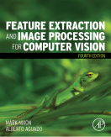
Lecture 2 Image Formation
COMP3204 Computer Vision
What is inside an image?
 | Book pp 29-38 57-66

Slide 2
Content
How is an image formed?
What restrictions are there on image formation?
Go to a different space - Fourier …..

Slide 3

Decomposing an image into its bits
The Most Significant Bit carries the most information where as bit 0 is noise
… and here, bit 4 is the lighting

Slide 4
Effects of differing image resolution
Low resolution lose information but N×N points implies much storage
How do we choose an appropriate value for N?

Slide 5
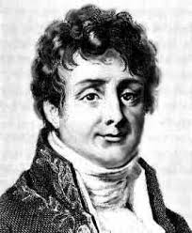
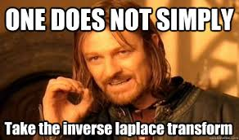
Joseph Fourier
Any periodic function is the result of adding up sine and cosine waves of different frequencies
Sceptical? Yeah, so were Lagrange and Laplace. Good company eh?
“Fourier’s treatise is one of the very few scientific books that can never be rendered antiquated by the progress of science” James Clerk Maxwell 1878

Slide 6
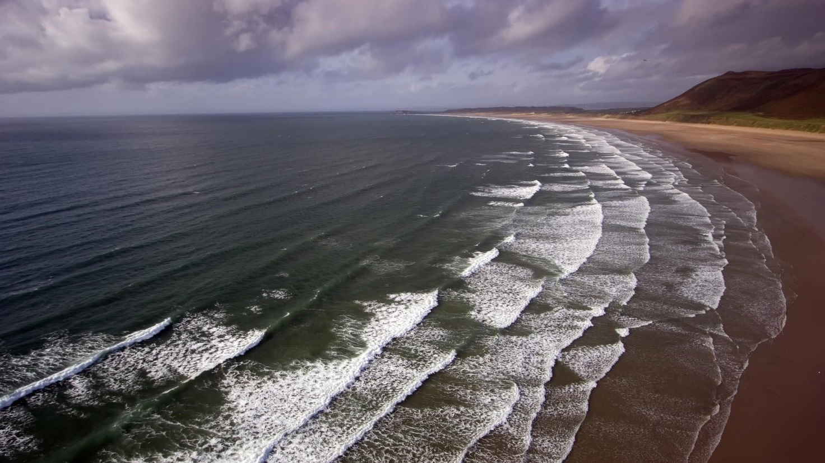
What are 2D waves?
2D waves are along x and y axes simultaneously

Slide 7
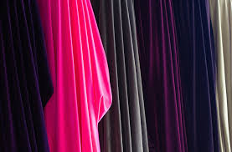
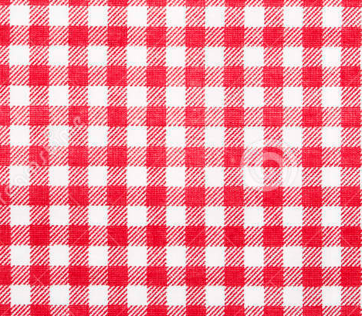
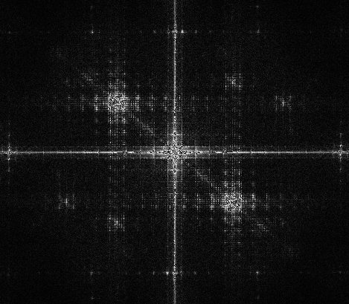
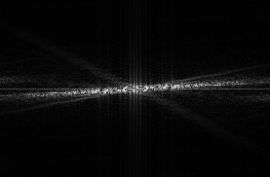
and in terms of frequency
N.b. colour immaterial (just for visuals)

Slide 8
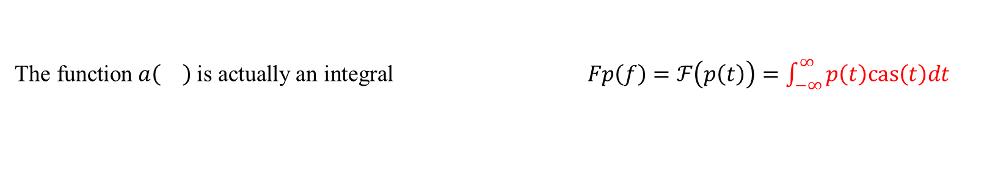
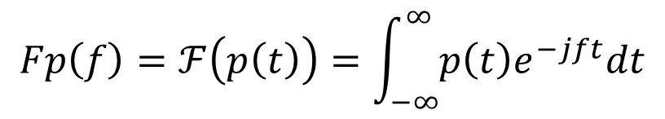

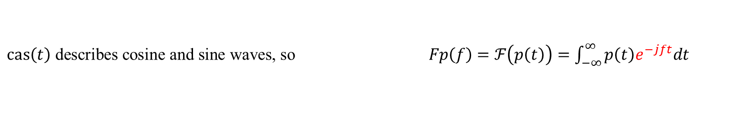
Step up Fourier…
$$Fp\left(f\right)=ℱ\left(p\left(t\right)\right)=\int_{−∞}^{∞}{p\left(t\right)e^{−jft}dt}$$
Whoa! Where from….
First, we have that the FT is a function $a\left(\right)$of a time-variant signal $p\left(t\right)$
The Fourier transform is then $Fp=a\left(p\left(t\right)\right)$
The transform is a function of frequency so $Fp\left(f\right)=a\left(p\left(t\right)\right)$
$ℱ$ stands for the Fourier transform so $Fp\left(f\right)=ℱ\left(p\left(t\right)\right)=a\left(p\left(t\right)\right)$
The function $a\left(\right)$is actually an integral $Fp\left(f\right)=ℱ\left(p\left(t\right)\right)=\int_{−∞}^{∞}{p\left(t\right)cas\left(t\right)dt}$
$cas\left(t\right)$ describes cosine and sine waves, so $Fp\left(f\right)=ℱ\left(p\left(t\right)\right)=\int_{−∞}^{∞}{p\left(t\right)e^{−jft}dt}$
where $cas$ = ‘cos and sin’ since $e^{−jft}=\cos\left(ft\right)−j sin\left(ft\right)$ ,
where $j$ is the complex number $j=\sqrt{−1}$

Slide 9
What does the Fourier transform do?
Addition in the time domain
Separation in the frequency domain

Slide 10
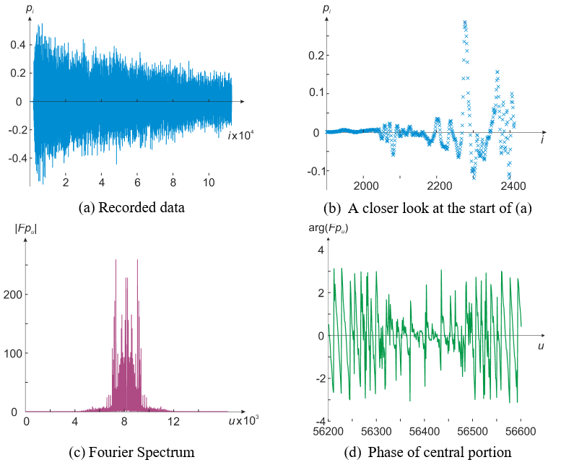
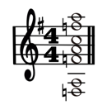
Hard day?
Let’s see the Fourier transform of the Hard Day’s night chord
Apparently, the piano is more dominant than expected

Slide 11
A rectangular pulse and its Fourier transform
Notes:
Can link to ideal low-pass filter, which is in Figure (b)

Slide 12
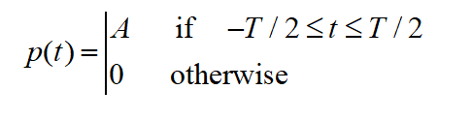
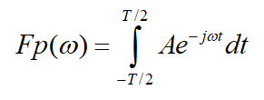
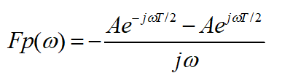
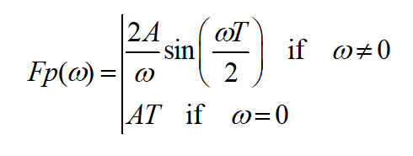
Pulse
Use Fourier
Evaluate integral
And get result

Slide 13
Reconstructing a signal from its Fourier transform
This is the inverse Fourier transform

Slide 14
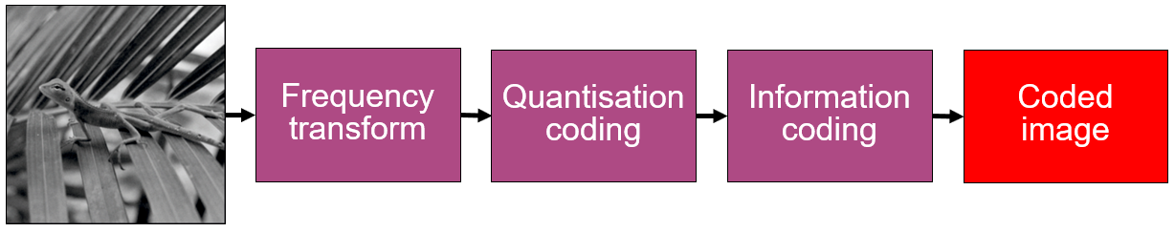
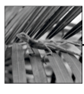
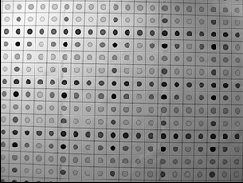
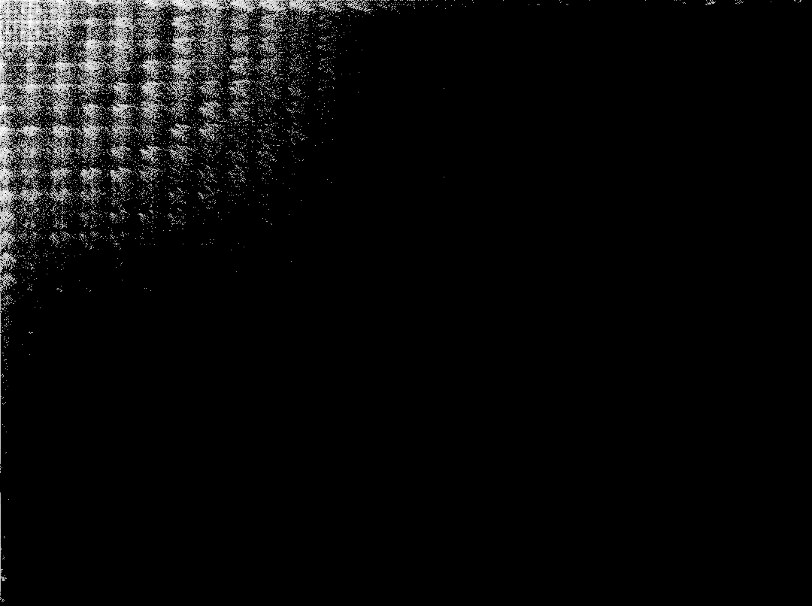
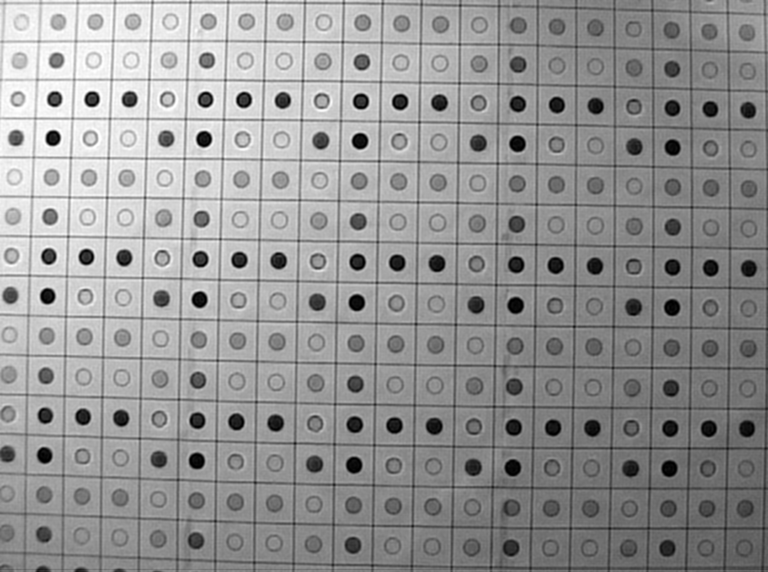
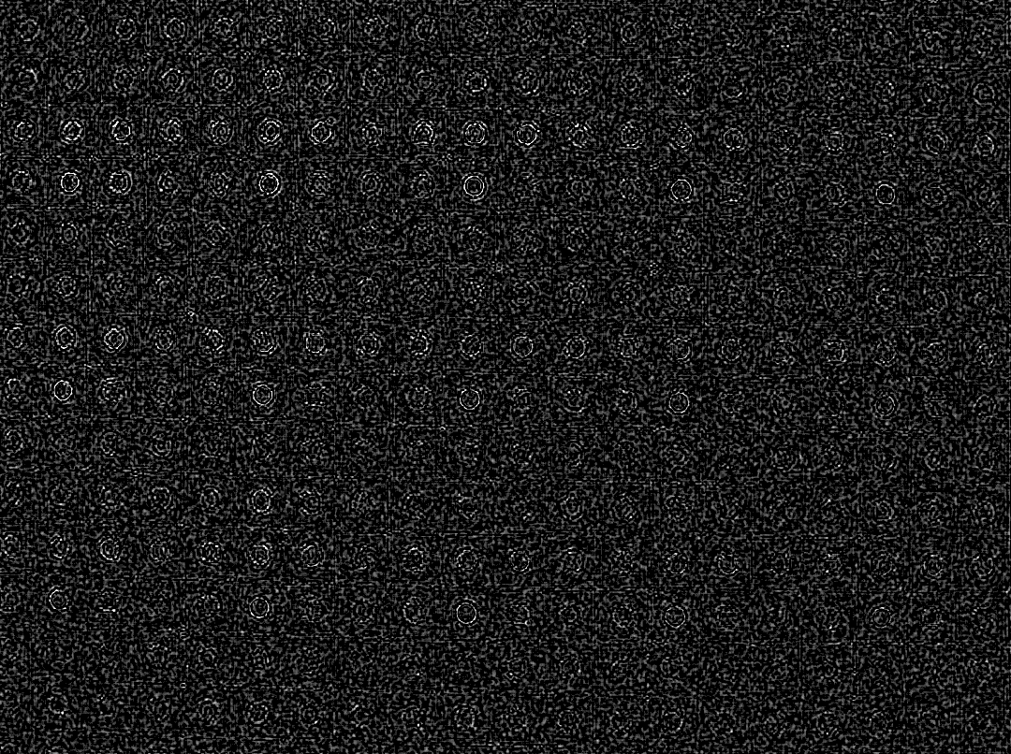
Inverse Fourier transform is used for reconstruction
Fourier transform
Inverse Fourier transform
5% of transform components
image
reconstructed image
error

Slide 15
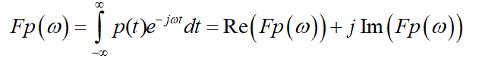
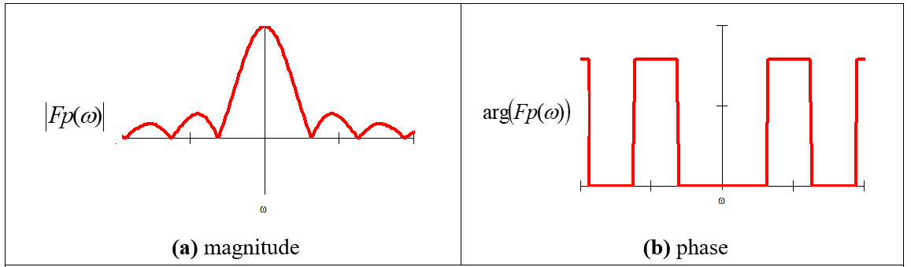
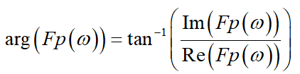
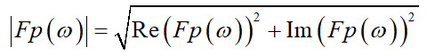
Magnitude and phase of Fourier transform of a pulse

Slide 16
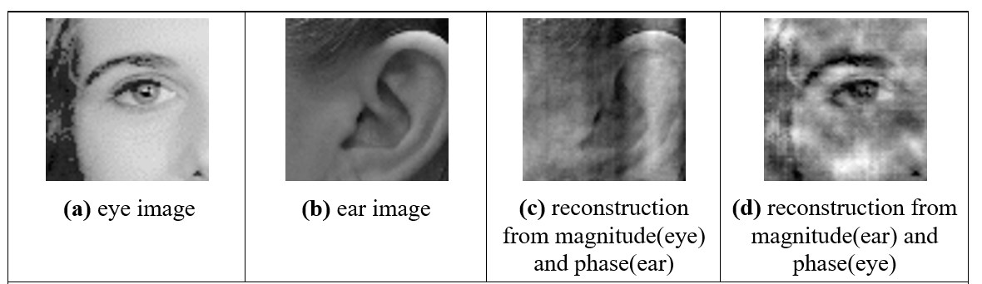
Illustrating the importance of phase

Slide 17

Main points so far
1 – sampling data is not as simple as it appears
2 – sampling affects space and brightness
3 – Fourier allows us to understand frequency
4 – Fourier allows for coding and more
Next, Fourier will allow us to understand sampling
Notes:
Mangos in portswood, yum yum

Slide 18
Other transforms
Discrete Cosine (Sine) Transform
Discrete Hartley Transform
Wavelets
Continuous wavelet
Discrete wavelet
Complex wavelet
Stationary wavelet
Dual wavelet
Haar wavelet
Daubechies wavelet
Morlet wavelet
Gabor wavelet
……
Curvelets
Shearlets
Bandelet
Contourlet
Fresnelet
Chirplet
Noiselet
……
Notes:
Mangos in portswood, yum yum

Slide 19
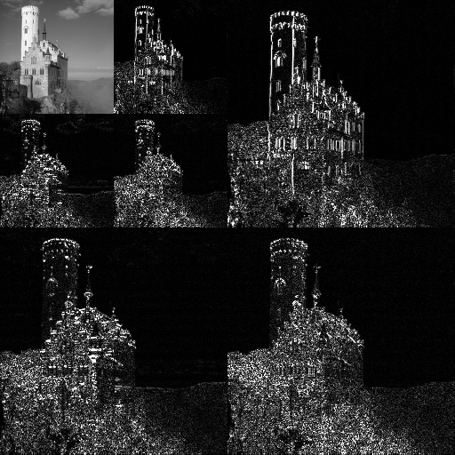
Wavelet transform
An example of the 2D discrete wavelet transform that is used in JPEG2000 [Credit: Wikipedia]
Notes:
Mangos in portswood, yum yum

